Slide 1
Use of Adaptive Coded Modulation (ACM) in wireless backhaul networks
British Telecommunications
Deutsche Telekom
Orange
Vodafone

Slide 2
Agenda
Background
How are typical backhaul links planned?
Statistics on usage of ACM and ATPC
Effects of propagation fading and interference
Consequences on the link if ACM and higher order modulations are not protected from interference
Consequences on the whole network if ACM and higher order modulations are not available
What is an acceptable Packet Loss Ratio?
Use of performance metrics for network maintenance
Conclusions

Slide 3
Background
Ongoing work item in CEPT SE19 study group studying protection criteria for fixed links (FS)
Members of ETSI ISG mWT follow the work in SE19
At the last ETSI ISG mWT plenary, an LS (SE19(23)025) was sent to SE19 with statistics of ATPC and ACM usage in European countries
With this contribution, mobile network operators attending ETSI ISG mWT would like to present how ACM is used in FS links for backhaul applications and the reasons why ACM must be protected from interference

Slide 4
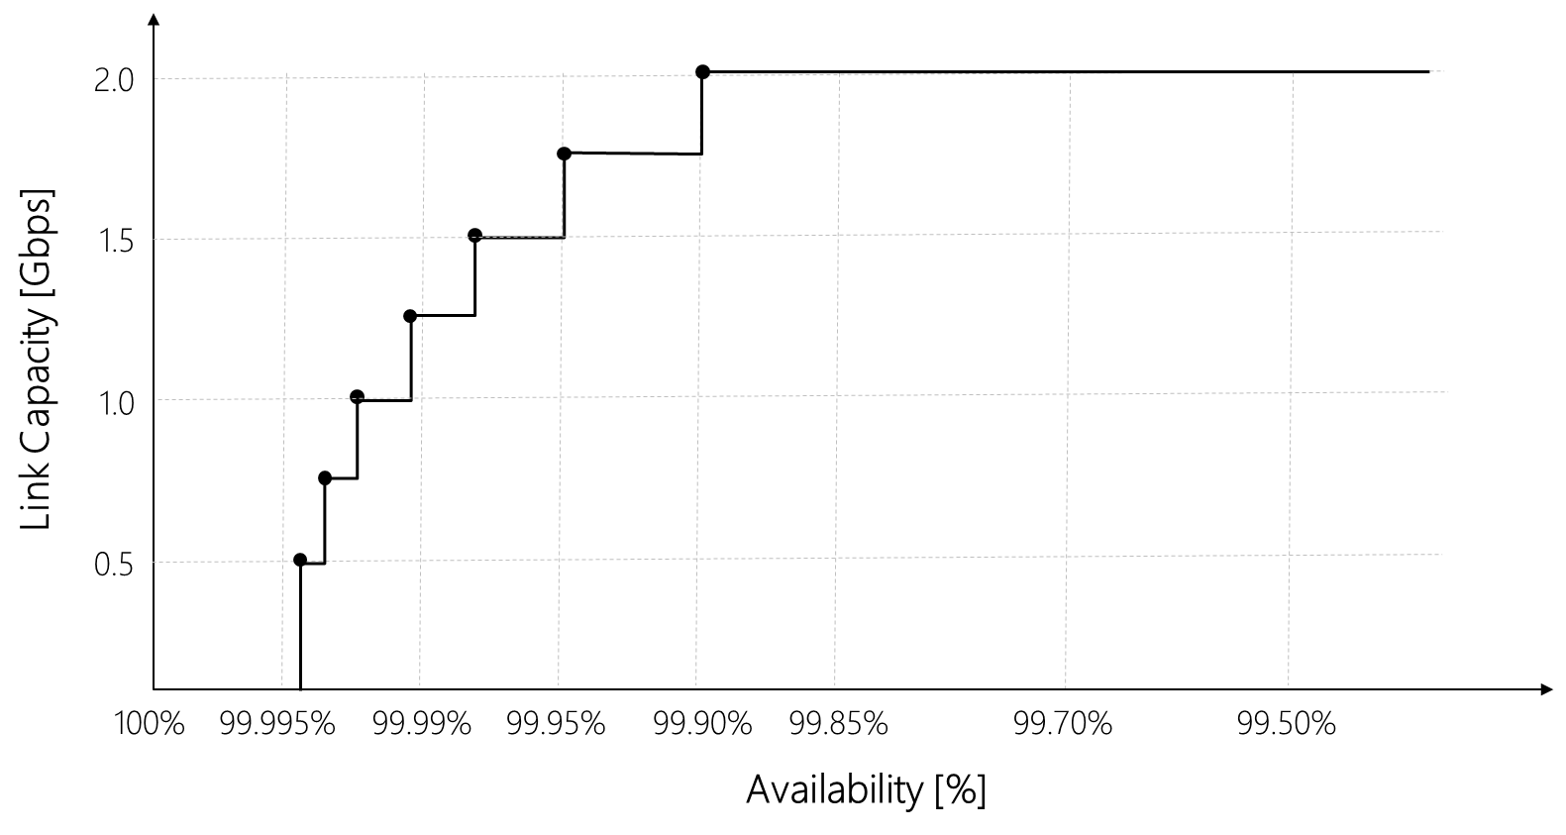
How are typical backhaul links planned?
Links are planned to provide a target reference capacity/modulation for an availability of ~99.9+% per year (in the order of few hour unavailability)
Using ACM, links switch modulations errorless above and below the target modulation as the propagation conditions allow
Using ACM, links operate 99.+% per year (in the order of few dozens hour unavailability) at modulation higher than reference such as:
  256QAM to 1-2 kQAM (depending on link type and link design details)
Link planning to get spectrum allocation is done using the reference modulation, which provides the spectrum mask and maximum power used for calculating the interference levels towards other PP links nearby in the network. The reference modulation is chosen by the operator and can be the target capacity or above, depending on the operator strategy.
Graceful capacity
degradation
Full Link Capacity
Reference modulation

Slide 5
Statistics on usage of ACM and ATPC
Operator #1
Operator #2
Operator #3
 |  | % Links deployed with
 |  | ATPC | ACM
Europe | AU | 1% | 100%
 | CZ | 91% | 68%
 | GE | 29% | 100%
 | GR | 0% | 95%
 | HU | 0% | 99%
 | MO | 0% | 99%
 | NL | 90% | 100%
 | NM | 100% | 100%
 | PL | 40% | 100%
 | RO | 0% | 95%
 |  | % Links deployed with
 |  | ATPC | ACM
Europe | AL | 0% | 100%
 | CZ | 95% | 100%
 | DE | 0% | 95%
 | ES | 0% | 75%
 | GR | 0% | 100%
 | IE | 0% | 100%
 | IT | 0% | 85%
 | PT | 95% | 100%
 | RO | 100% | 60%
 | UK | 0% | 100%
 | TR | 30% | 95%
 |  | % Links deployed with
 |  | ATPC | ACM
Europe | UK | 0% | 97%
Operator #4
Europe |  | % Links deployed with
 |  | ATPC | ACM
 | BE | 80 | 100
 | FR | 50 | 70
 | MD | 10 | 100
 | PL | 0 | 100
 | RO | 0 | 90
 | SK | 100 | 100
Europe | ES | 1 (plan for 100) | 100
ACM is used virtually in all links

Slide 6
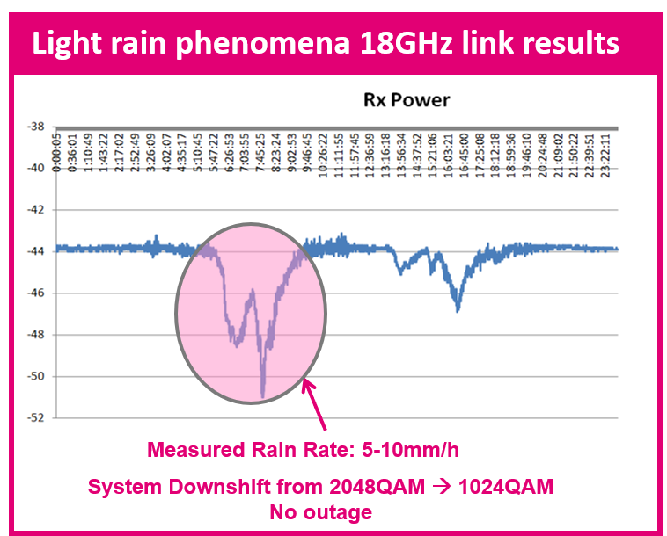
Effects of propagation fading and interference
In case of propagation fading or presence of increased level of a continuous interference, the equipment (detecting MSE¹ degradation) will reduce ACM level before bit errors occur, resulting in a lower link capacity
  Unavailability of all modulation formats due to propagation conditions is taken into account when doing link planning
  Unavailability due to interference cannot be planned and this will create traffic congestions if it happens especially during busy hours
In case of bursty interference, the increase in instantaneous interference cannot be detected by the MSE, therefore the equipment will not reduce the operating modulation, and this will:
  Generate packets losses on backhaul traffic (increasing Packet Loss Ratio (PLR))
  Trigger ES, SES and (possibly) UAS events (recorded by link PM counters) depending on burst duration and periodicity
¹MSE (Mean Square Error) of the received symbols (integrated over propagation-appropriate time window)

Slide 7
Consequences on the link if ACM and higher order modulations are not protected from interference
If the ACM mechanism and the higher order modulations are not protected from interference, operators would have to reconsider deploying links relying on these features and revert to fixed modulation systems
Backhaul links are supposed to work errorless because
  retransmission is not a technical option at layers 1 to 3
  a single error means a packet loss
  packet loss triggers E2E re-transmission at layer 4 (e.g. TCP) reducing network bandwidth and impacting all services
Not being able to use higher modulations (512 QAM and above) in conjunction with ACM will also reduce the applicability of certain bands
  For example, E-band (71-76 GHz, 81-86 GHz) or multiband links will be limited to short distances making them impractical
  This also implies no 2-10 Gigabit connectivity = no 5G wireless backhaul
Fixed higher QAM links result in shorter links and denser backhaul networks, which is not an option (radio sites could not densify for transmission reasons, adding transmission sites is huge cost)

Slide 8
Consequences on the whole network if ACM and higher order modulations are not available
Overall, by not being able to rely on the ACM, the network as a whole will experience several consequences
  Reduced Data Rates: ACM adjusts the modulation and coding schemes to achieve higher data rates when the link quality allows. If higher modulations cannot be used due to interference, the data rates will be limited to lower modulation schemes, resulting in reduced throughput and slower data transmission.
  Increased Latency: Because of using lower modulations, the time required to transmit a given amount of data will increase, leading to higher latency in the network. This increased latency can negatively impact real-time applications like video conferencing or online gaming.
  Reliability Issues: Errors in the communication link can lead to packet loss and data corruption. This can result in retransmissions, which increases the overhead and reduces the overall network efficiency. In extreme cases, the network may experience connectivity issues and service interruptions.
  Quality Degradation: In multimedia applications like video streaming or voice communication, errors can cause noticeable degradation in the audio or video quality. Users may experience interruptions, artifacts, or audio/video distortion, leading to a poor user experience.
  Impact on Network Services: If the link quality consistently remains below the required level for higher modulations, the network may have to adapt by providing services at lower data rates, which could affect service offerings and user expectations.
5G Low Latency and 5G uReliable (future) services will tolerate even less backhaul errors

Slide 9
What is an acceptable Packet Loss Ratio?
Several Recs for E2E service targets can be found (such as the following):
  ITU-T 1541: requesting max PLR in the range 1E-3 to 1E-5 (depending on type of service)
  3GPP TS 23.203: requesting max PLR in the range 1E-3 to 1E-6 (depending on type of service)
All these Recs will result in following best practice targets for single node (backhaul link) in order to accommodate all service types:
  Ideal behaviour (for all services): PLR < 1E-5 (0.001%)
  Not acceptable (for any service): PLR > 1E-3 (0.1%)
  1E-5 < PLR < 1E-3: area triggering investigations (traffic congestion, node failure, etc.)
Average data packet length today is in between 1000 and 1500 bytes; voice packet length is around 100 bytes

Slide 10
Use of performance metrics for network maintenance
UAS, SES and ES defined at layer 1 are used as compelling events triggering MW link maintenance analysis
  With high to low priority considering UAS, SES and finally ES
  These metrics are baseline for both manual maintenance (traditional approach) as well as with automated maintenance (driven by algorithms sitting on NMS or SDN platform)
  Can indicate phenomena outside just pure channel fading conditions. As an example, antenna mis-alignments or HW degradation could be reflected in increased ES and SES.
  These parameters are not defined by ITU-T for the customer premises (CP)
Such parameters have been defined by ITU-T according to the media-independent approach requested by the ITU, so that they are applicable to every network element, including the ones belonging to the fixed transport network. This is commonly used as vertical technology (MW domain) maintenance approach, complementing the E2E service approach based on PLR (see previous slide)
  that cannot detect all issues deserving maintenance in a MW link
  that cannot locate where the PLR issue is taking place (RAN, Transport, which node in the transport, etc.)
While such metrics maybe considered less directly relevant for packet transport networks, they are adequate until a more suitable metric / KPI is proposed or widely adopted. KPIs such as PER may be reflective of link congestion.

Slide 11
Conclusions
ACM is a ubiquitous part of MW backhaul networks
It allows for higher capacities and improves the spectrum efficiency of MW links
Network operators rely on ACM and the higher modulations (512 QAM and above) although provided at slightly lower availability
Erroneous ACM operation due to interference will lead to reduced data rates, increased latency, reliability issues, quality degradation, reduced applicability of certain bands and will impact netwok services
Therefore, ACM operation is and will become even more a vital part of 5G wireless backhaul links and must be protected from interference

Slide 12
Backup

Slide 13
ACM Principles
Behaviour of a system using ACM under adverse weather or interference conditions
Adaptive Modulation (AM) is a technology where the modulation mode can be adjusted automatically according to the channel quality:
Weather and/or interference phenomena
When the ACM technology is used, the radio adaptively adjusts the transport bandwidth on the air interface.
When the radio link between the air interfaces is of poor quality (for example, in the case of heavy rain or fog), the equipment uses the lower modulation scheme to improve the availability of the link so that the quality of transmitting the important user data is guaranteed.
Severe weather & interference phenomena can cause a downshift on the modulation state

Slide 14
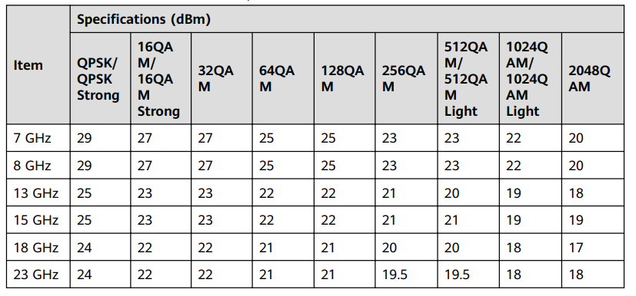
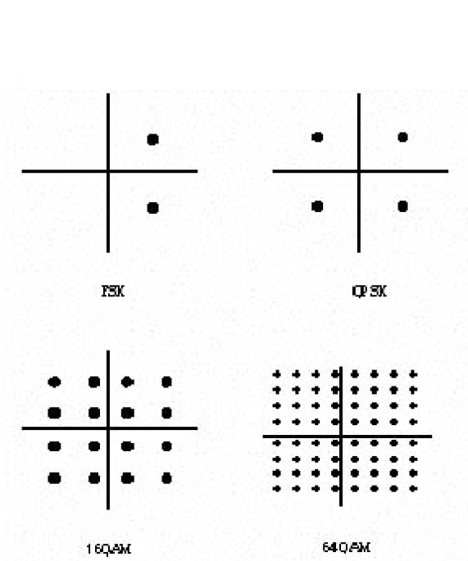
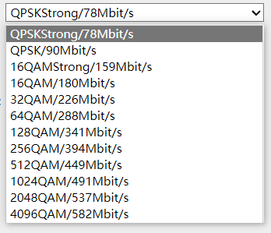
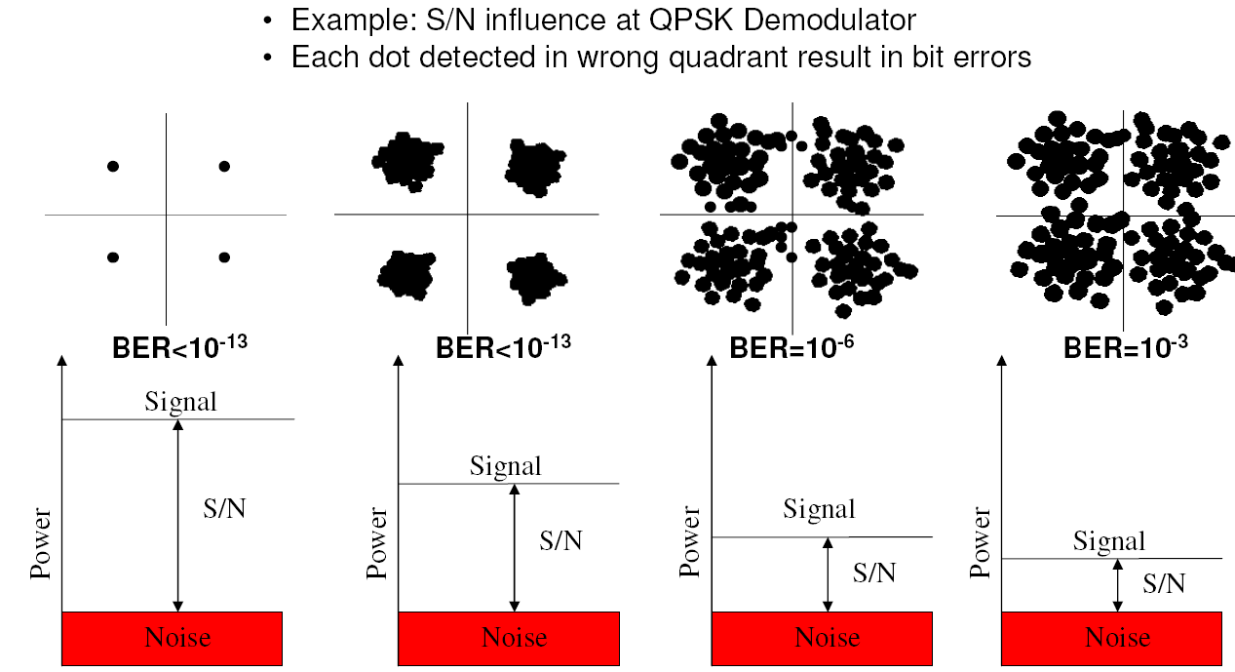
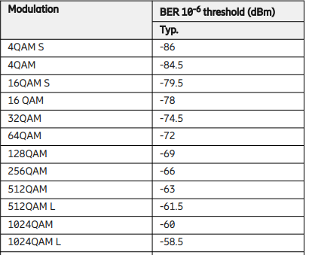
ACM Mechanism
Modulation Vs Tx Power:
Lower Modulation = Higher Tx output power
The more points in the constellation, the closer they are to each other, making them more susceptible to noise and interference. A QPSK transmitter can use less power to achieve the same level of signal quality as 64QAM.
QPSK uses a constellation with four points, representing different combinations of phase shifts. Higher order modulation, uses a constellation with many points, representing combinations of both phase and amplitude changes:
Modulation Vs Throughput:
Lower Modulation = Lower Throughput
Higher order modulation schemes can transmit more data compared to QPSK systems because they encode more information in each symbol.
Modulation Vs Rx Sensitivity:
Lower Modulation = Higher Rx Sensitivity
As the constellation points get closer together, the receiver of a higher order modulation system becomes more sensitive to noise and interference. Low order systems can demodulate the signal at a lower SNR.
Lower modulation schemes have lower throughput but a better SYSTEM GAIN which means:
HIGHER LINK AVAILABILITY

Slide 15
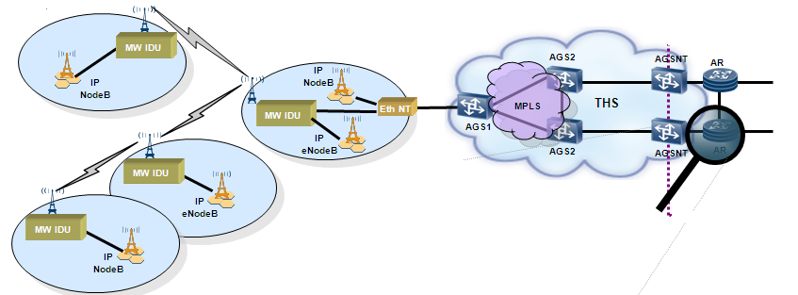
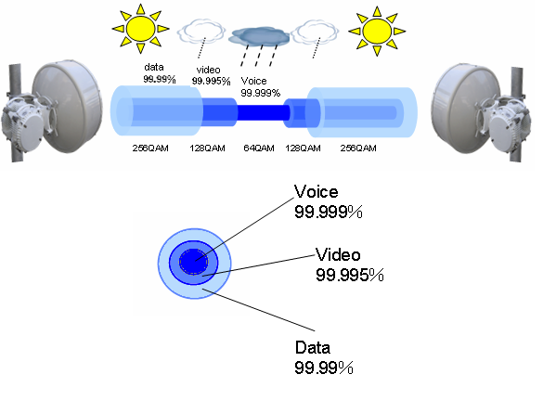
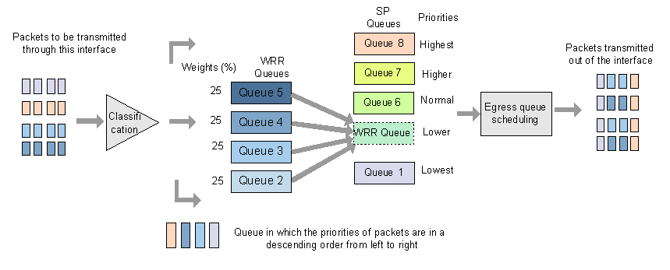
Wireless Transport QoS & ACM Mechanism
WBH ≈ 50% of MBH last mile connectivity in DT networks:
Target Availability per Service type:
8 queues typically used on the radio equipment:
Different modulation due to interference/weather conditions → different bandwidth/throughput
Different services → different priorities

Slide 16
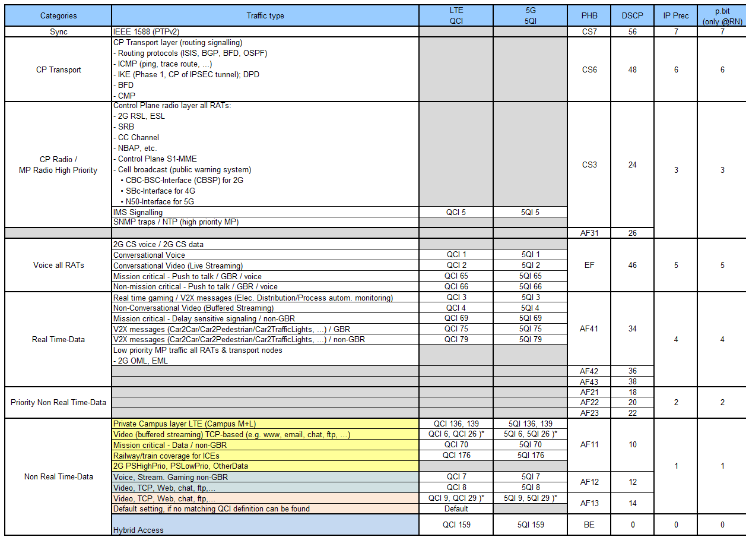
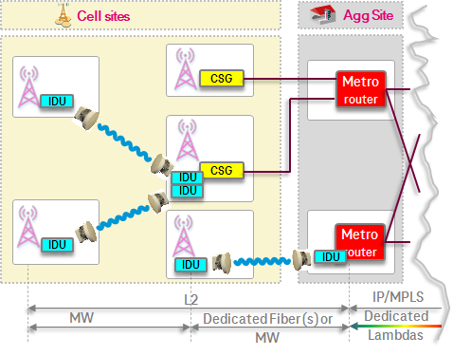
Example from Service Types – QoS mapping
Radio Access services QoS mapping on Transport Network
Services have different characteristics, requirements & classification but EVERY TYPE OF SERVICE IS IMPORTANT

Slide 17
Interference vs PLR example
Example figures related to PLR targets
  Assuming average packet length of 1200 bytes (typical in data networks today)
  Assuming MW link speed of 1 Gbps (112 MHz channel, 1024QAM)
  There will be more than 104k (1E+5) packets flowing on the link every second
  If PLR sampling (counter) period is 10s (typically is 5 to 15 sec on equipment)
  PLR target < 1E-5 means less than 10 packet losses every 10 second
Result
  indicates that 1 interference burst per second
  could be sufficient to fail PLR < 1E-5

